Slide 1

Object Detection with YOLOv3 and OpenCV
Project by : -
Mridul Sharma E22CSEU0149
Aryanan Sharma E22CSEU0147

Slide 2
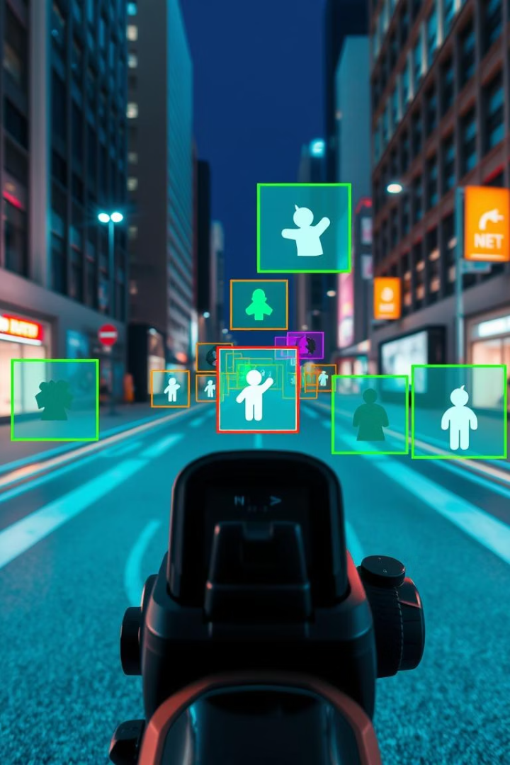
Introduction to Object Detection
What is Object Detection?
Project Goal
Implement real-time object detection using YOLOv3 with OpenCV.
Identifying and locating objects in images or videos for applications like surveillance and autonomous vehicles.
Performance Highlights
Mean Average Precision: 57.9%, Speed: 30 frames per second.

Slide 3
YOLOv3 Model Architecture
Core Algorithm
Key Features
YOLO (You Only Look Once) detects objects using a single neural network.
Darknet-53 backbone for feature extraction
Multi-scale predictions at 13x13, 26x26, and 52x52 grids
Processes images in real-time.
Uses anchor boxes like 10x13, 16x30, and 33x23 pixels

Slide 4
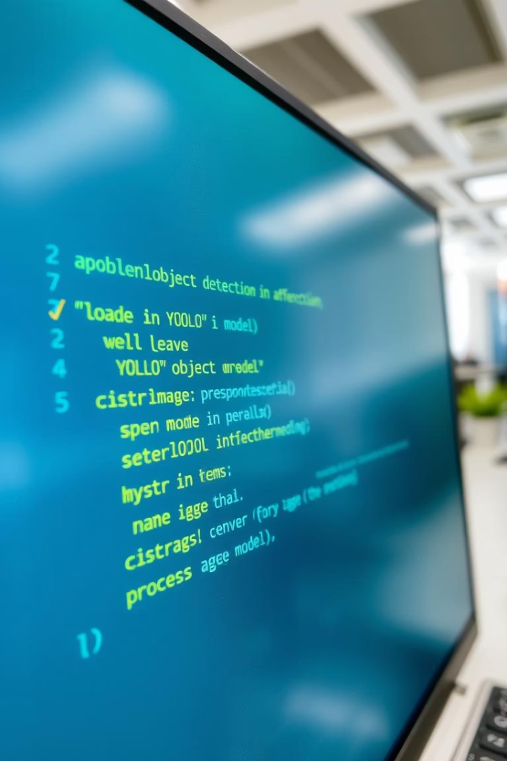
Implementation with OpenCV
1
Model Setup
2
Preprocessing
Load YOLOv3 weights and config using OpenCV's dnn module.
Resize images to 416x416 and scale pixel values.
3
Postprocessing
Apply Non-Maximum Suppression with IoU threshold 0.6 to filter boxes.

Slide 5
Results and Demonstrations
Performance Metrics
Comparisons
Precision: High
Outperforms Faster R-CNN and SSD in speed and accuracy balance.
Recall: Strong detection coverage
F1-score: Balanced accuracy
Detects 80 distinct object classes effectively.

Slide 6
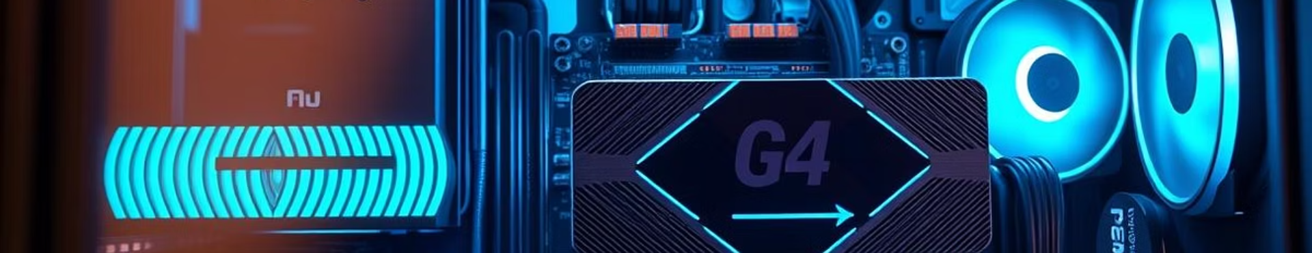
Challenges and Solutions
Memory Constraints
Optimization Techniques
Accuracy Improvements
Managed resource usage to prevent overflow during processing.
GPU acceleration enabled real-time inference performance.
Used data augmentation and confidence threshold tuning to reduce false positives and negatives.

Slide 7
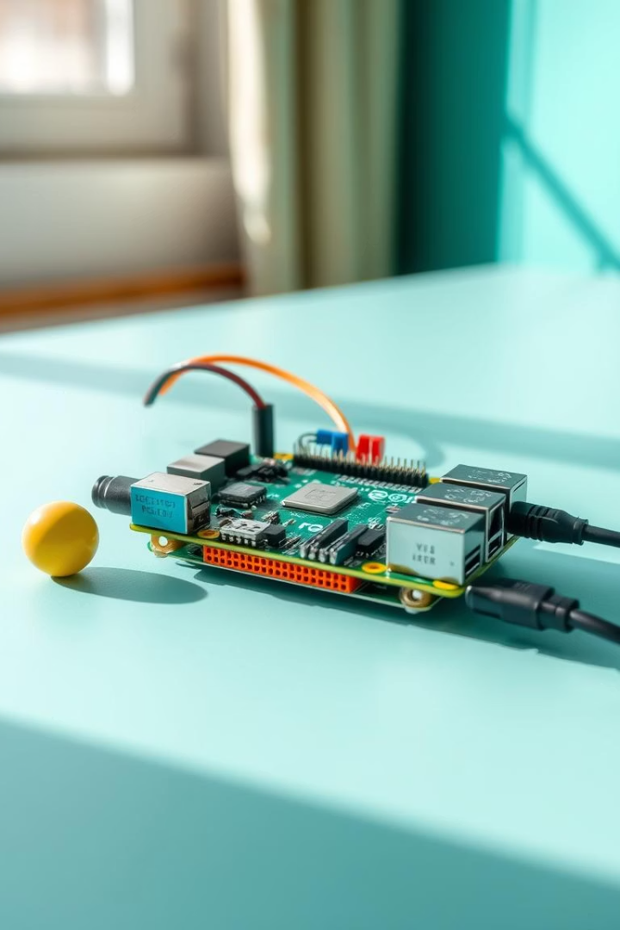
Future Work
Expand Training Data
Use larger datasets like COCO and ImageNet for better accuracy.
Integrate Object Tracking
Implement DeepSORT for tracking detected objects across frames.
Edge Deployment
Optimize model deployment on devices like Raspberry Pi.
Model Quantization
Explore quantization to improve efficiency and speed.

Slide 8

Conclusion
Project Highlights
Impact
Next Steps
Achieved real-time object detection using YOLOv3 and OpenCV efficiently.
Enables applications in security, autonomous systems, and analytics.
Further research on tracking and edge device integration.

